Slide 1
Device manager

Slide 2
What Is Device Manager?
Device Manager is an extension of the Microsoft Management Console that provides a central and organized view of all the Microsoft Windows recognized hardware installed in a computer.
Device Manager is used to manage the hardware devices installed in a computer like hard disk drives, keyboards, sound cards, USB devices, and more.
You can use Device Manager to change hardware configuration options, manage drivers, disable and enable hardware, identify conflicts between hardware devices, and much more.

Slide 3
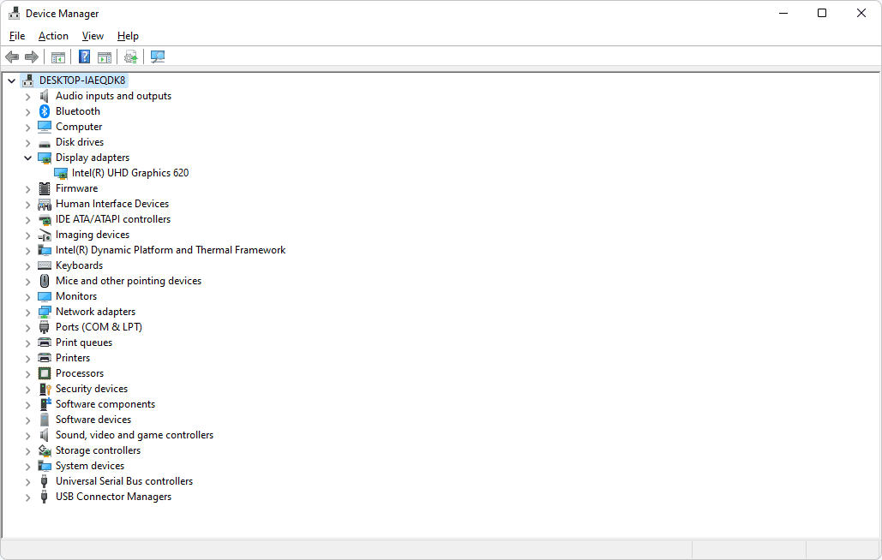

Slide 4
Device Manager Availability Device Manager is available in nearly every Microsoft Windows version including Windows 11, Windows 10, Windows 8, Windows 7, Windows Vista, Windows XP, Windows 2000, Windows ME, Windows 98, Windows 95, and more. How to Access Device Manager Device Manager can be accessed in several different ways in all versions of Windows, most commonly from the Control Panel, the Command Prompt, or Computer Management. However, a few of the newer operating systems support some unique ways for opening Device Manager. How to Open Device Manager in Windows 11, 10, 8, 7, Vista, or XP.

Slide 5
How to Use Device Manager
Device Manager lists devices in separate categories so that it's easier to find what you're looking for. You can expand each section to see which devices are listed inside. Once you find the right hardware device, double-click it to see more information like its current status, driver details, or in some cases its power management options.
Some of these categories include Audio inputs and outputs, Disk drives, Display adapters, DVD/CD-ROM drives, Network adapters, Printers, and Sound, video and game controllers.
If you were having troubles with your network card, let's say, you might open the Network adapters area and see if there are any unusual icons or colors associated with the device in question.

Slide 6
Shared folders

Slide 7
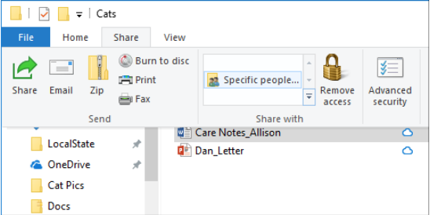

Slide 8
Share files or folders over a network
To share a file or folder in File Explorer, do one of the following: 1. Right-click or press a file, select Give access to > Specific people.
2. Select a file, select the Share tab at the top of File Explorer, and then in the Share with section select Specific people.
If you select multiple files at once, you can share them all in the same way. It works for folders, too—share a folder, and all files in it will be shared.

Slide 9
Stop sharing files or folders
To stop sharing in File Explorer, do one of the following: 1. Right-click or press a file or folder, then select Give access to > Remove access.
2. Select a file or folder, select the Share tab at the top of File Explorer, and then in the Share with section select Remove access.

Slide 10
Services and Applications

Slide 11
Definition of services
A Windows service is an application that usually serves a core operating system function running in the background and has no user interface. The Windows operating system makes use of these applications or services to do what an OS does, such as manage network connections, play sound, provide file system functionality, provide security and authentication, display colors and interact with the user through the GUI.
The following are some characteristics of Windows services:
• Always running
• No UI
• Run in a separate Windows session, so are available to all users
• Offer recovery actions

Slide 12
Definition of application
A program that is written to run under the Microsoft Windows operating system, also called a "Windows app." All 32-bit Windows applications run in the 32-bit and 64-bit versions of Windows. All 64-bit applications require 64-bit Windows, which is the standard on new Windows computers and tablets. Older 16-bit Windows applications can run in the 32-bit versions of Windows, including Windows 95, 98, XP, Vista, 7, 8 and 10. However, 16-bit applications do not run natively in the 64-bit versions of Windows

